Slide 1
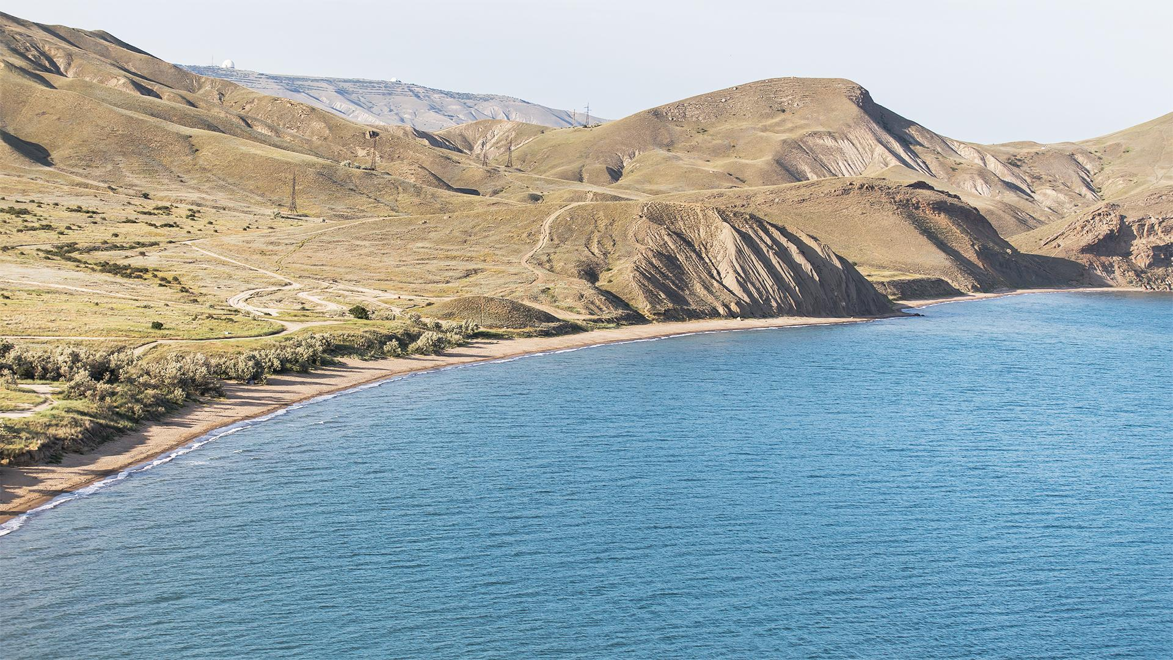
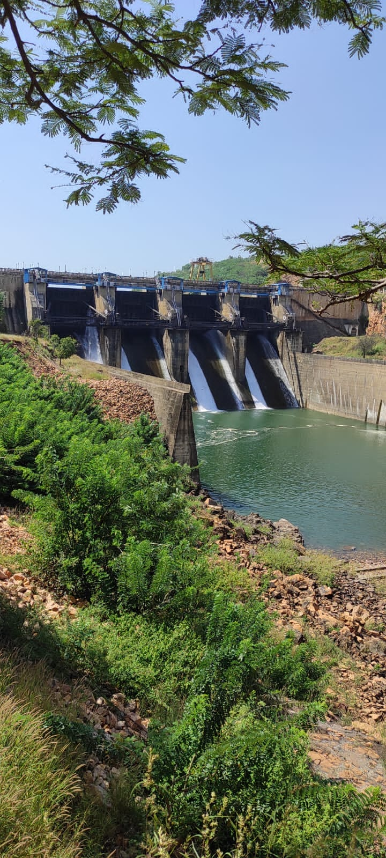
Malaprabha -
Preliminary experiment
Jagadeesh karu-190030020
Sirisha-190020031
Fidha-190030014
Kanwaldeep Edewar-190030019

Slide 2
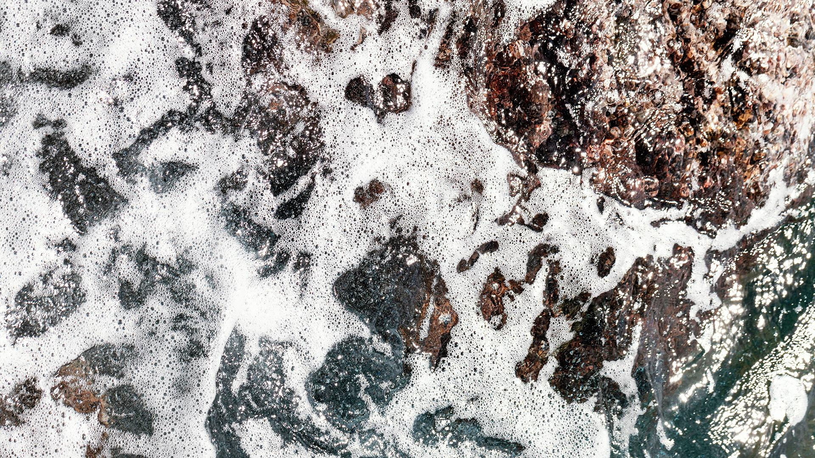
We plan to study the future water availability in the dry regions of Karnataka, in view of the expected Drought and Extreme Rainfall in the coming decade, by analysing the Malaprabha Catchment region

Slide 3
METHODOLOGY
1. Observed daily Rainfall data and Hourly Water flow rate for
Malaprabha
Carry out
2. Numerical Modeling of the water flow in the Catchment area
using the Basic Equations of Hydrodynamics.
3. Conduct a field trip to measure the water percolation down due
to gravity and water Diffusion due to gradient of water saturation
of the soil.

Slide 4
01
DAILY RAINFALL DATA
We were the given rainfall data in the nc file. By using python code we will get all data

Slide 5
RAINFALL DATA
We have rainfall data from Indian Metereogical department sensing interpolated rainfall in India
Python code: In this code we will give latitude,longitude and date and it will give rainfall at that point.
Code:
import xarray as xr
import pandas as pd
pd.set_option('display.max_rows', None)
from google.colab import drive
drive.mount('/content/gdrive/', force_remount = True)
ds = xr.open_dataset('/content/gdrive/MyDrive/Malaprabha/RF25_IMD0p252019_Final.nc')
df = ds.to_dataframe()
df.to_csv('data.csv')
df = pd.read_csv('data.csv')
df['TIME'] = pd.to_datetime(df['TIME'], format='%Y-%m-%d')
df = df.sort_values(by = 'TIME')
df.head(20)
selected_df = df.loc[(df['LONGITUDE'] == 73.25) & (df['LATITUDE'] == 36.25) & (df['TIME'] >= pd.Timestamp(2019, 1, 1)) & (df['TIME'] <= pd.Timestamp(2019, 4, 16))]
selected_df = selected_df[~selected_df['RAINFALL'].isna()]
# selected_df = df.loc[(df['LONGITUDE'] == 73.25) & (df['LATITUDE'] == 36.25) & (df['TIME'] == pd.Timestamp(2019, 2, 1))]
# selected_df = df.loc[(df['LONGITUDE'] == 70.00) & (df['LATITUDE'] == 16.5)]
# selected_df = df['TIME'] == pd.Timestamp(2019, 4, 16)
selected_df

Slide 6
The Rainfall data for each grid are made into data frames .
We got the rainfall of each grid per each day in the month of August 2019 from the code .
We got the average rainfall of each day from 1st August 2019 to 31st August 2019
We produced a histogram depicting the Average Rainfall per each day in the month of August 2019
We produced histograms for all the 10 grids (each) with x-axis as days in August 2019 and Average rainfall in mm.

Slide 7
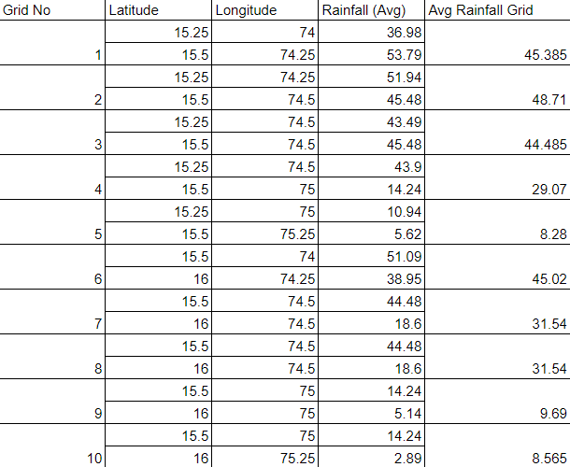
Avg Rainfall of each grid

Slide 8
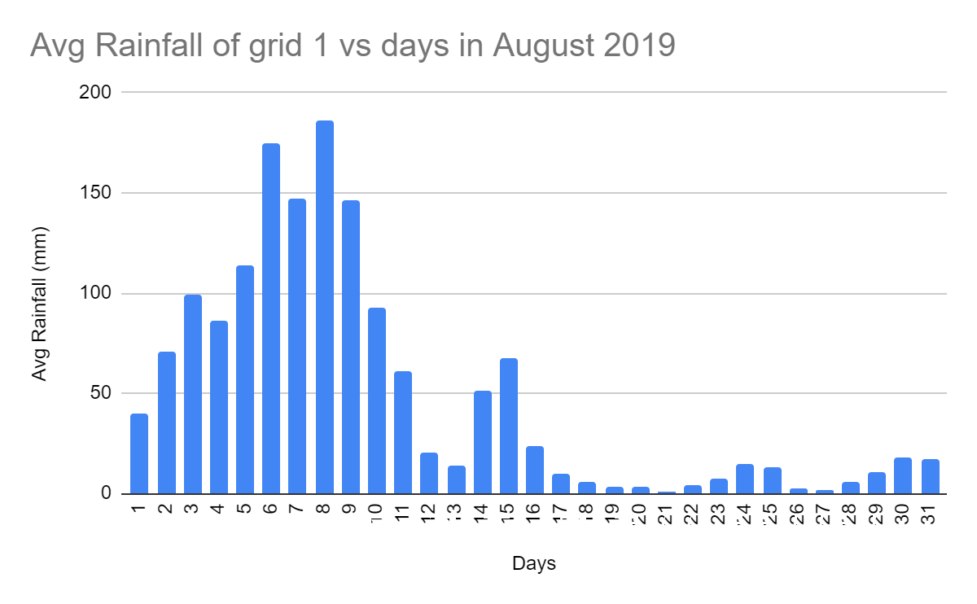

Slide 9
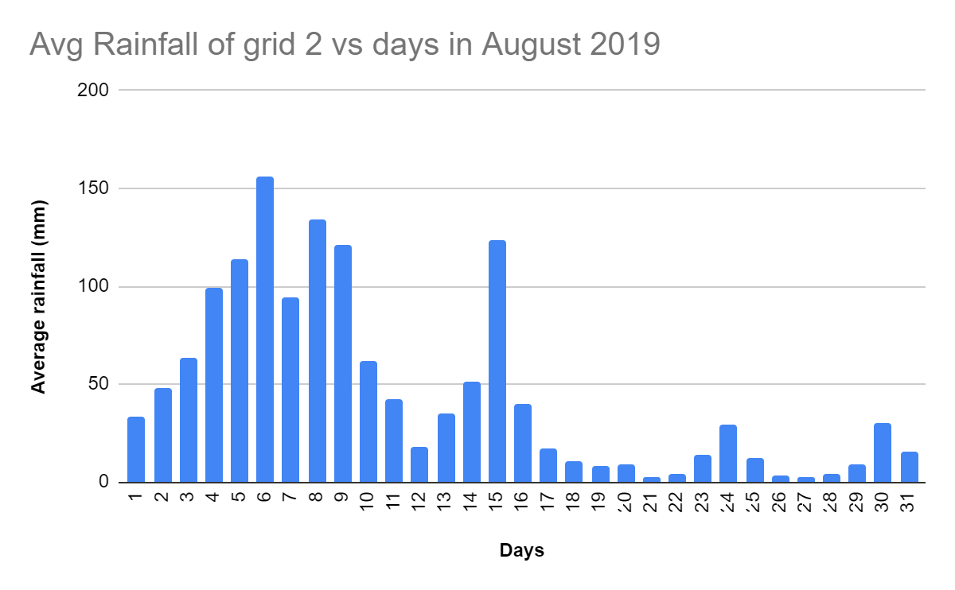

Slide 10
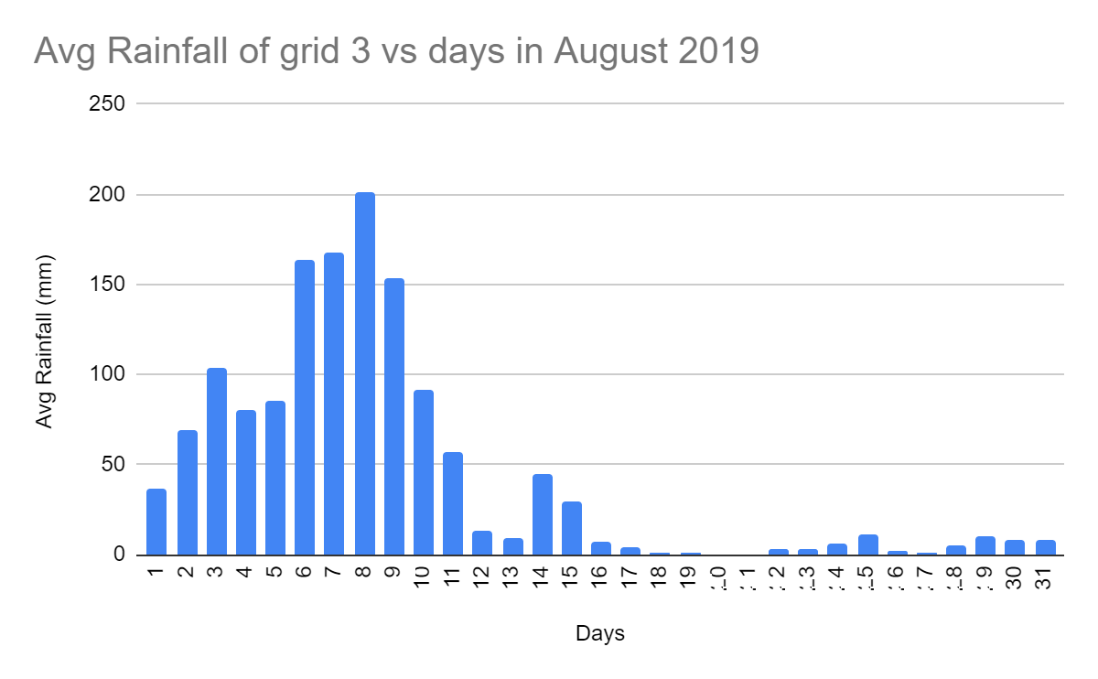

Slide 11
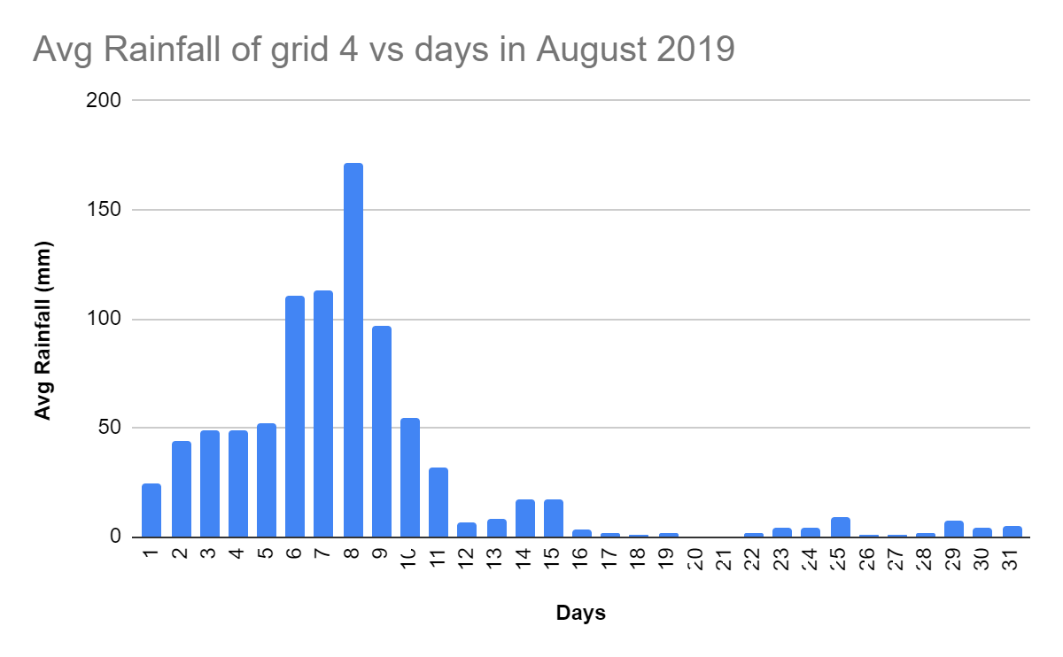

Slide 12
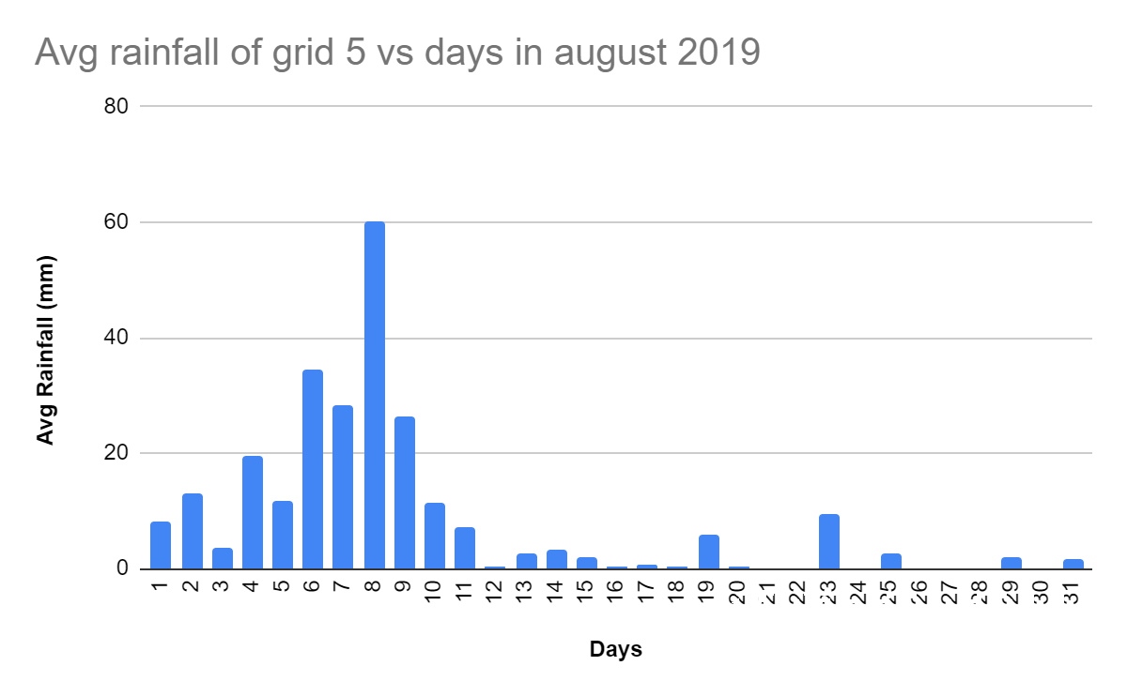

Slide 13
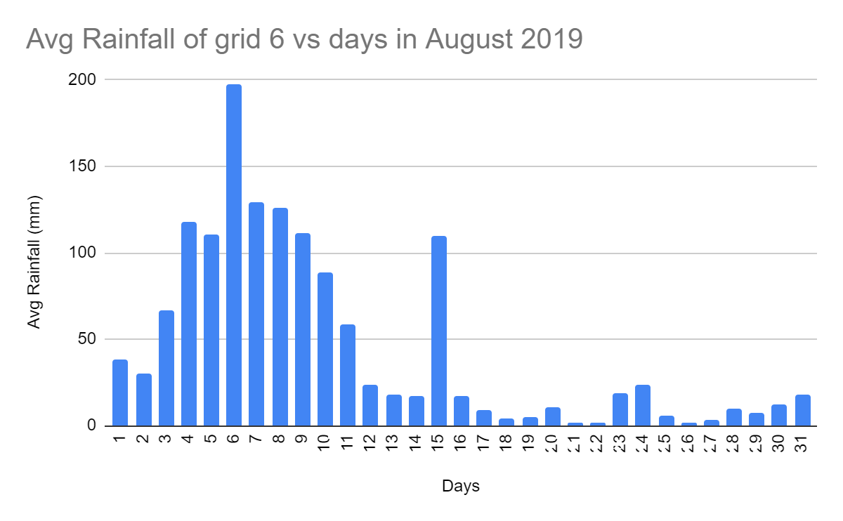

Slide 14
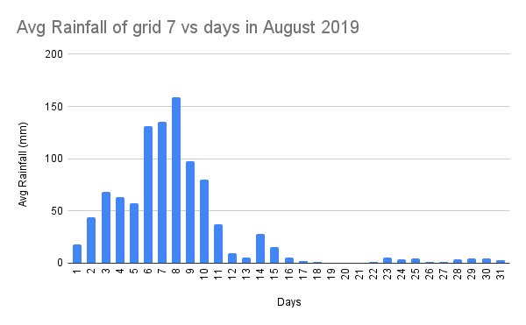

Slide 15
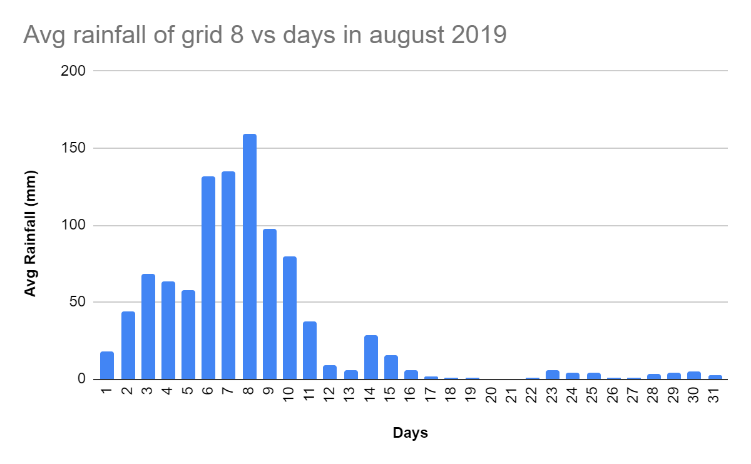

Slide 16
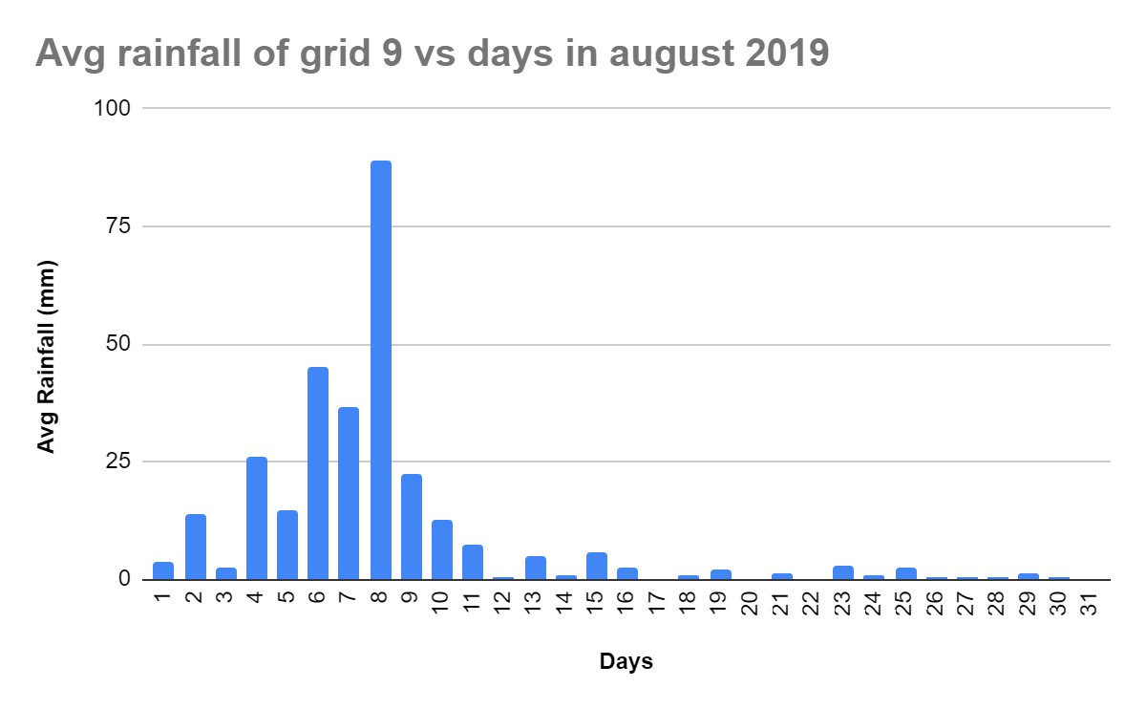

Slide 17
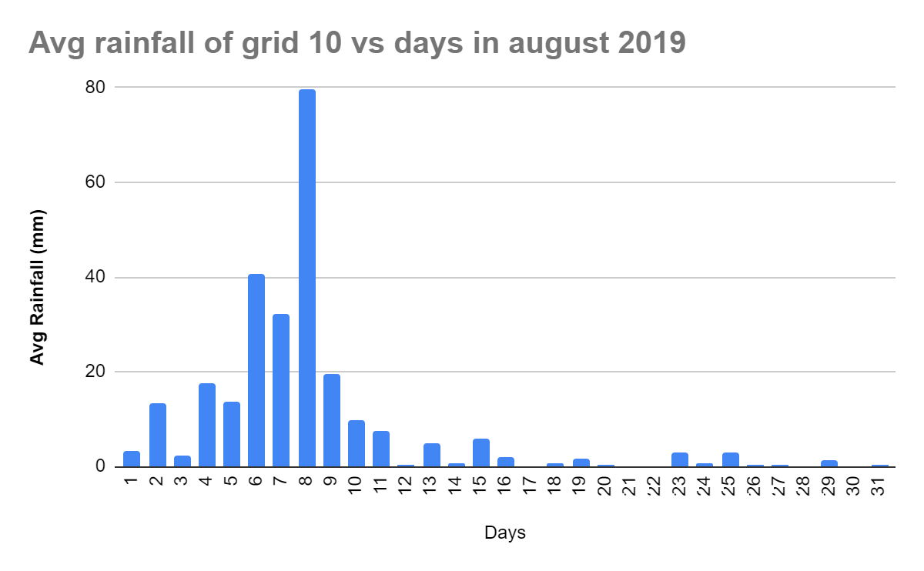

Slide 18
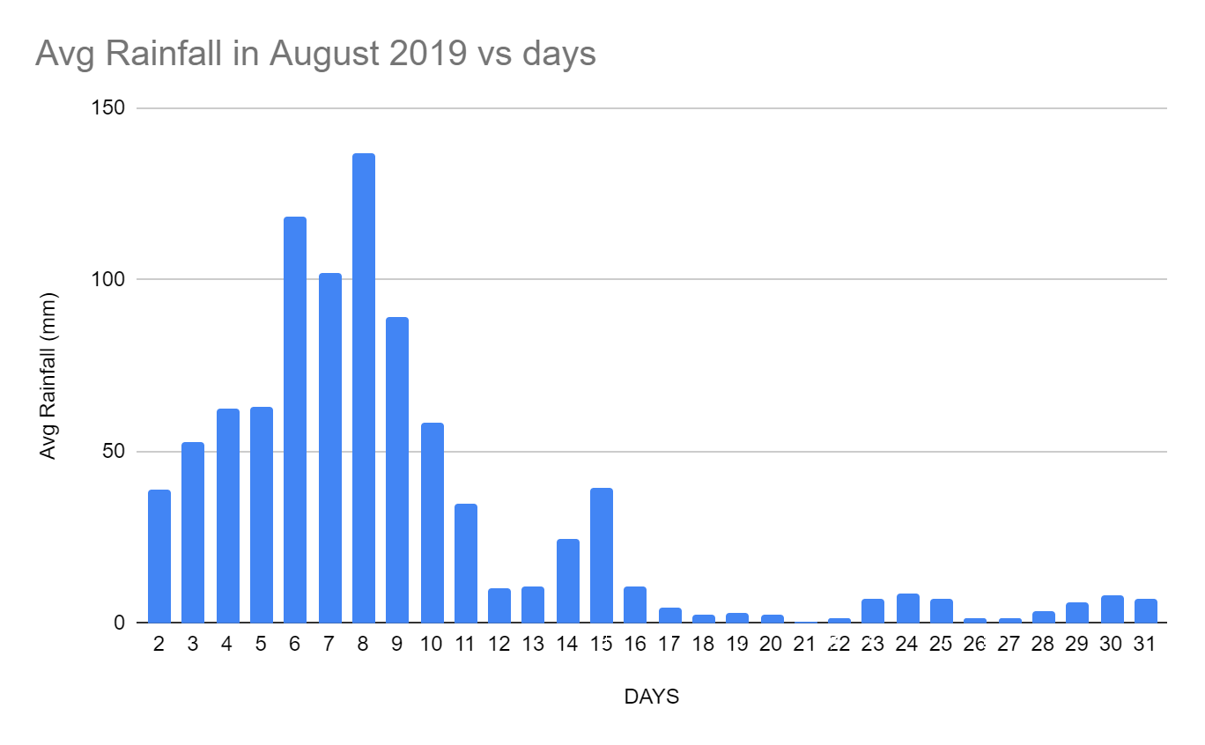

Slide 19
02
NUMERICAL
MODELLING
By using momentum equation and conservation of water equation, we will solve all equations and we will get graphs

Slide 20
Our main agenda of this project is we have to velocity of a flow and how much water is going to the malaprabha .
Here we will use Navier Strokes equation and conservation of mass equation.
Percolation and diffusion rate we got to know from the field trip, where we did some various soil experiments and got the results.
The range of the catchment 15.25’N 74.08’E to 16.05’N 75.10’E .
In this catchment area about 13000 sq m ,we are making 8 grids to 16 grids and going for calculation.

Slide 21
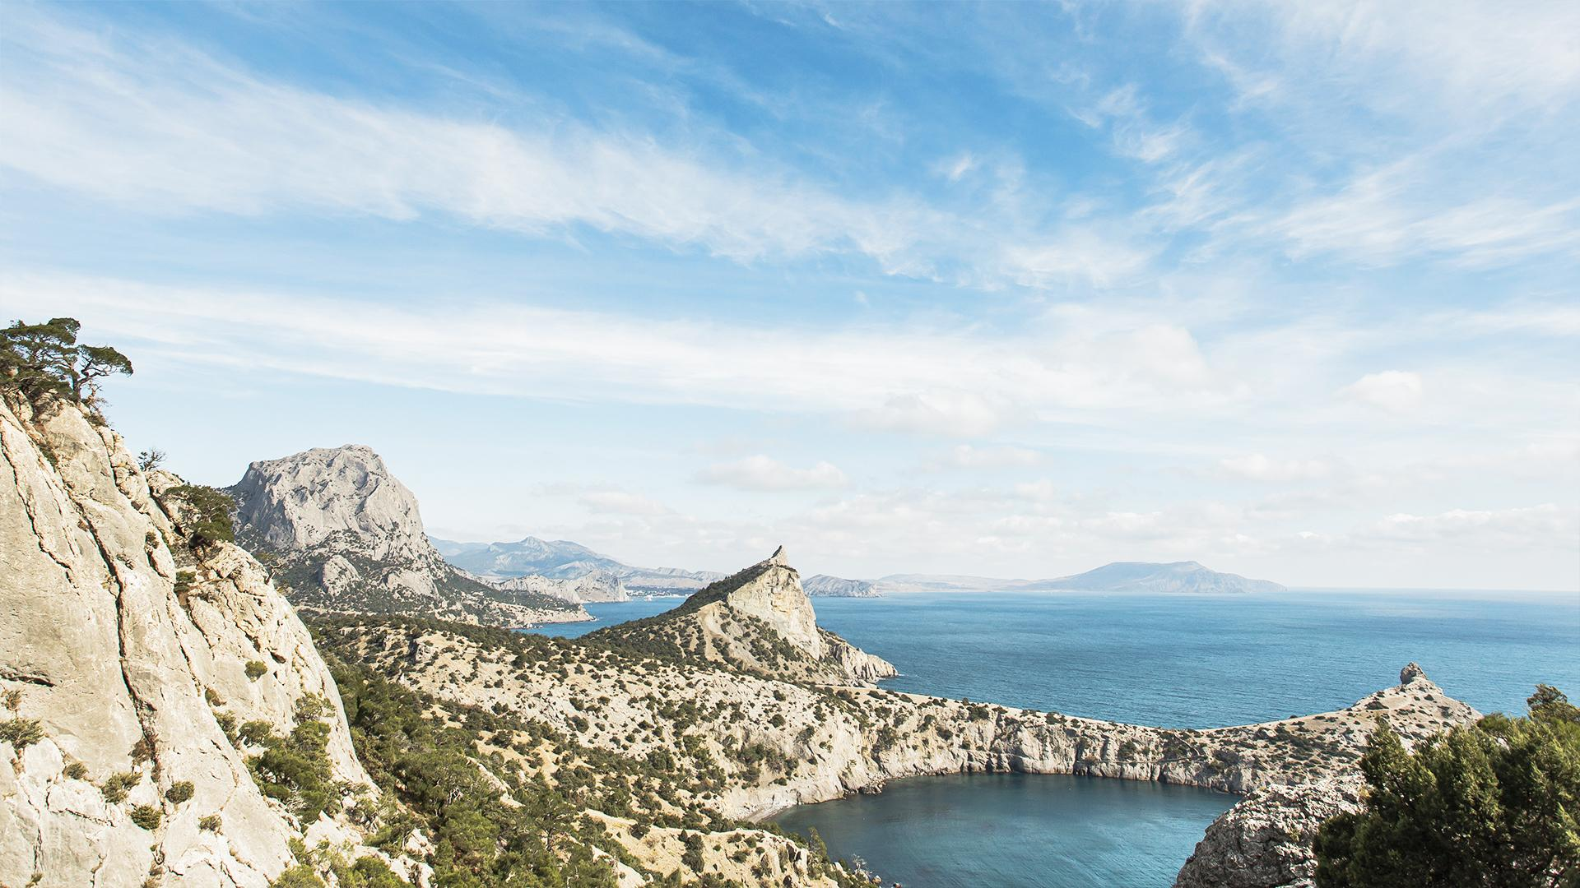
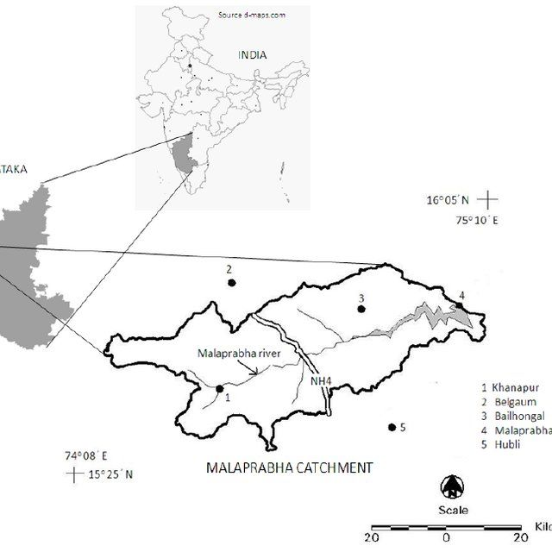
MALAPRABHA CATCHMENT

Slide 22
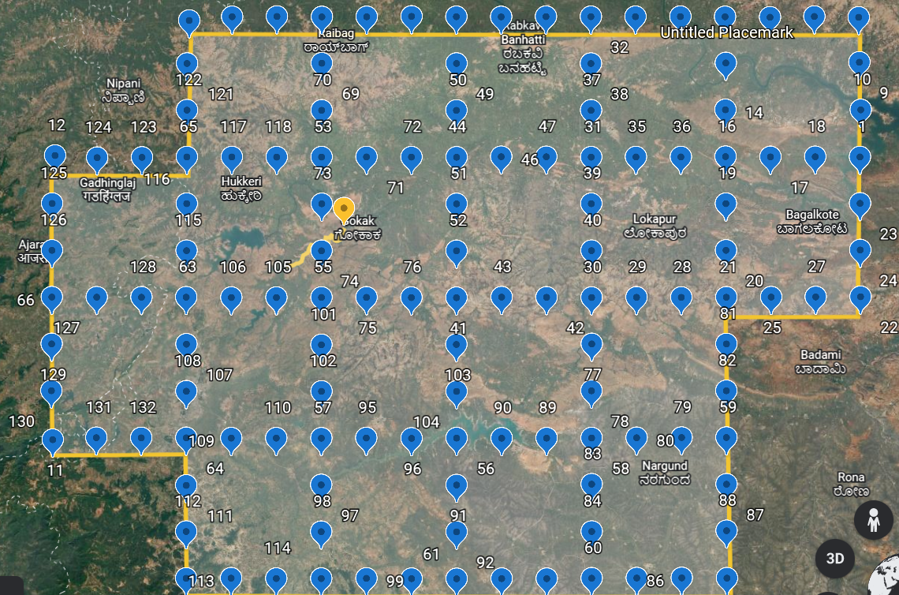
CATCHMENT REGION INTO GRIDS

Slide 23
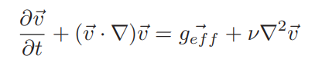
SPEED CALCULATION
Momentum Equation
Here we are taking a steady flow so, the dv/dt will be zero and the equation will be
v(dv/dx)=g*(slope resultant)+ u∇2v
v- speed of flow
g-acceleration due to gravity
u-kinematic viscosity, here we are taking 0.1m^2/s
geff- g x resultant slope of the grid

Slide 24
Here each grid size is 28 km
Some assumptions we took for the sake of calculations,
We are taking v=0,dv/dx=0 for the starting where the origin of malaprabha in the western ghats.
By taking v=0, dv/dx=0 we will get d2v/dx2 easily
For the second grid, since we knew d2v/dx2 for the previous one so,
* dv/dt of second equals to (d2v/dx2)*length of grid size
* v=l*(dv/dx)
It will go all grids and then we can simply find the speed of the flow .

Slide 25
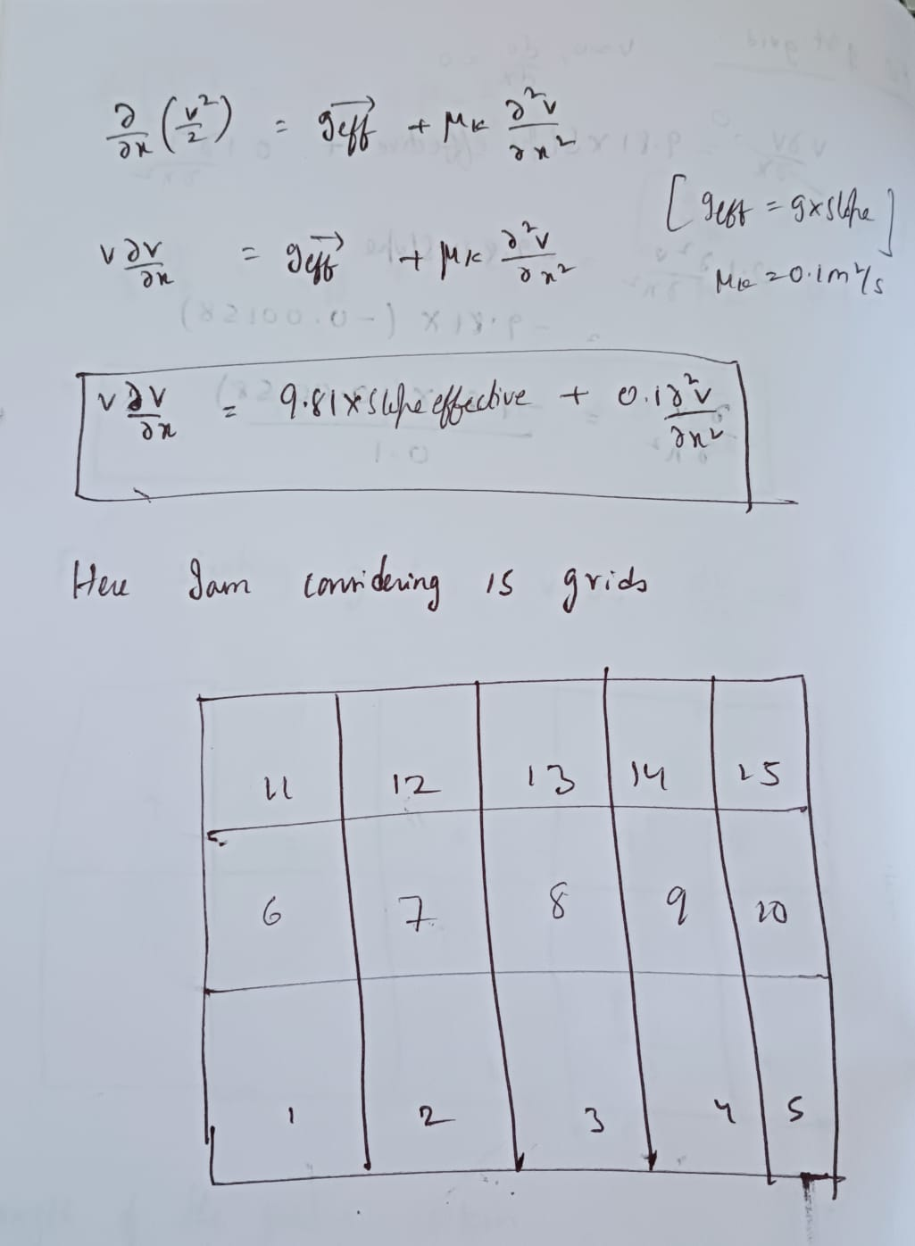

Slide 26
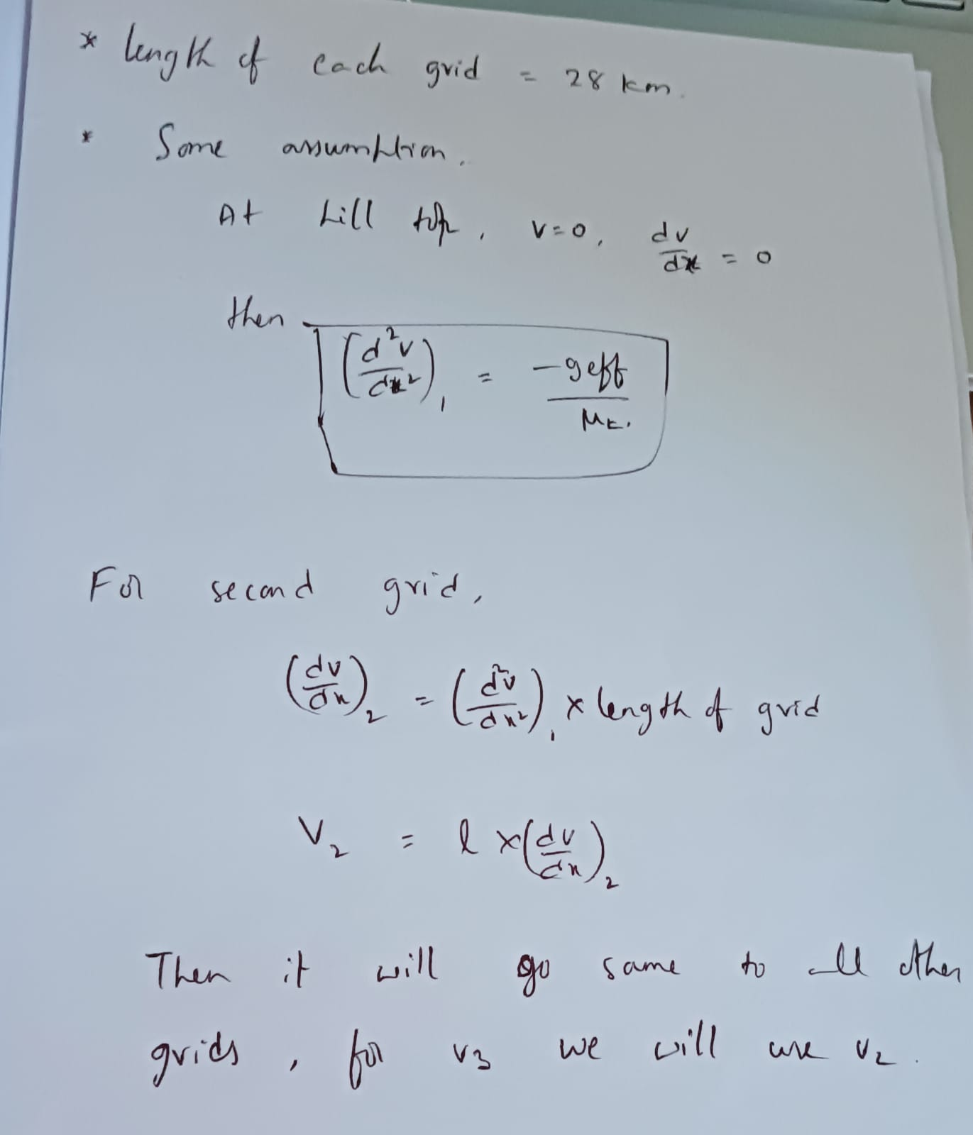

Slide 27
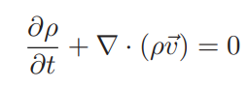
Conservation of mass
Here we are neglecting evaporation, as it is relevant during heavy rain.
Here, ρ is the amount of water (rain fall) in suitable units. However, v consists of three components
Laminar flow on the surface (outward and inward for each grid)
We pour specified amount of water in a small circular area and observed its infiltration as well as diffusion upto a specified distance.

Slide 28
∂ρ/∂t = rainfall / time
We are rainfall at particular grid and calculating the rate of rainfall in 24 hours.
∇.(ρv) has two terms
1) Infiltration downwards(here it will be 0.03cm/hr)
2) Water coming previous and water going to the next.
There is a evaporation about 38cm in the whole year we are neglecting during flooding, it is irrelevant.
Absorption by soil, we are neglecting at the time flooding because the soil is already saturated.
∇.(ρv) = Water coming from previous grids - Infiltration - water going out to next grid.
We consider mean flow along a streamline leading to Malaprabha river for all the derivatives occurring.
Here we are taking speed in the time part as 1m/s , like this is the optimising condition.

Slide 29
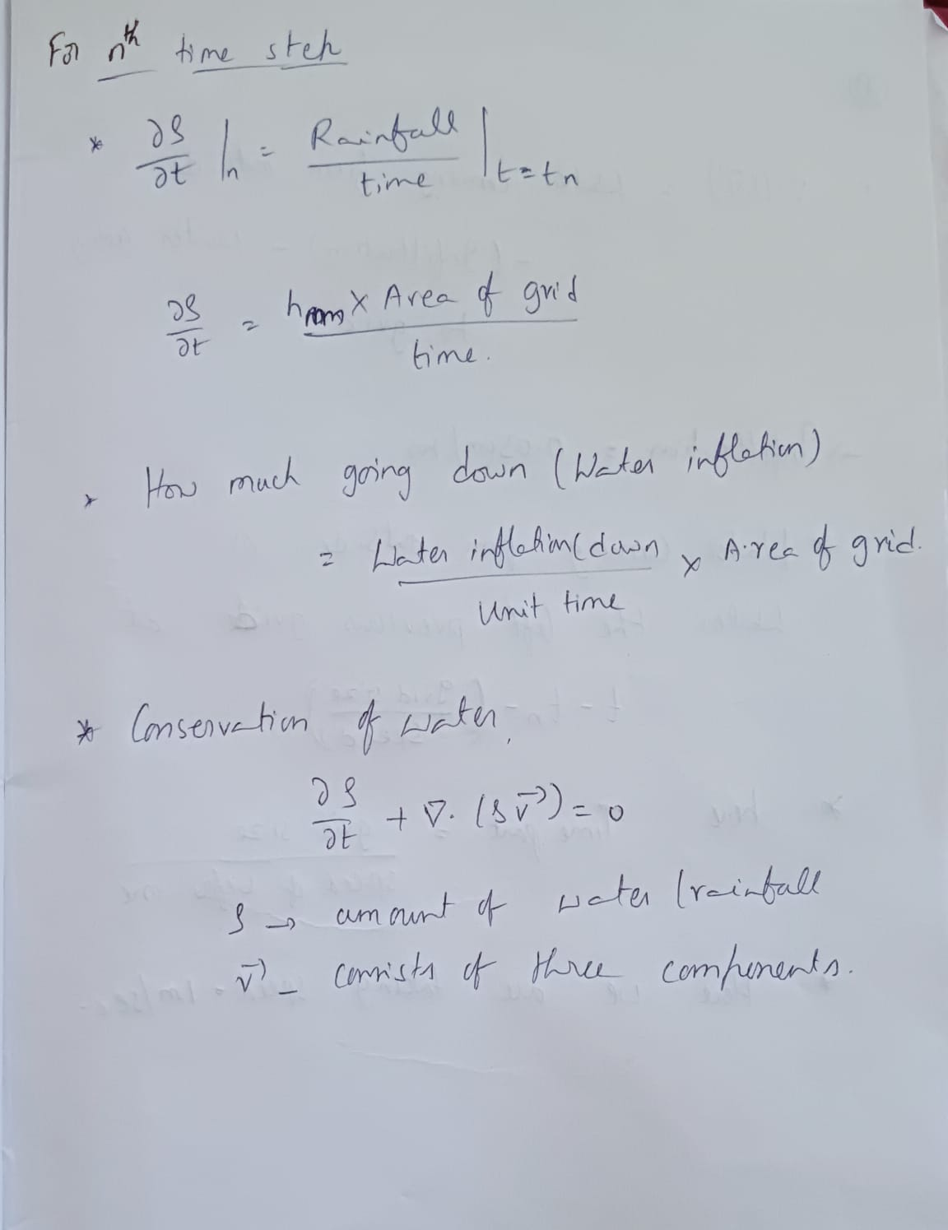

Slide 30
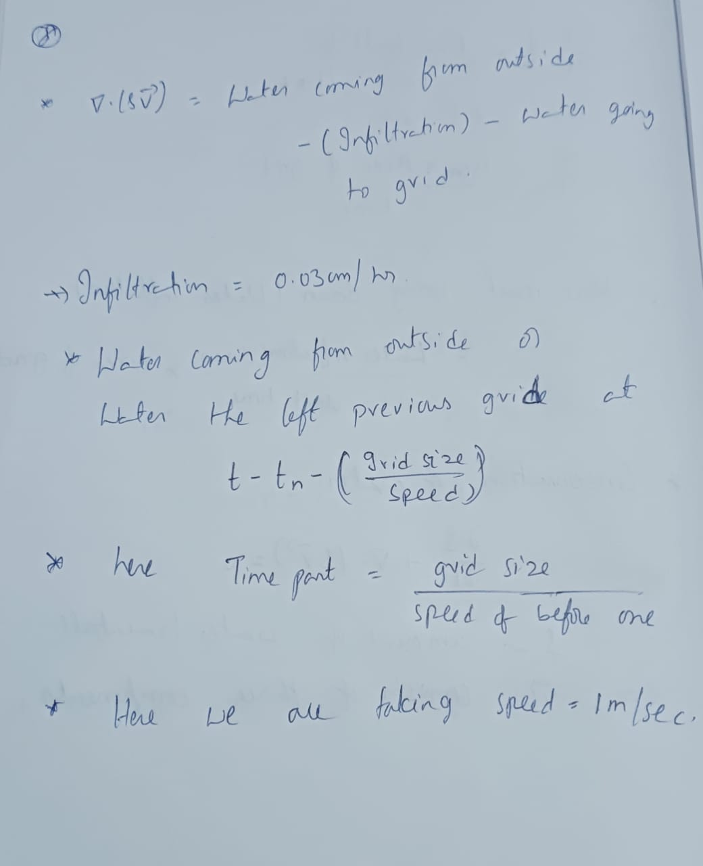

Slide 31
We have done all calculations in excel sheet .
And we have calculated for august 2k19 and here we got rainfall and how much water is going to malaprabha river.
By these calculations, we come to know how much water is going down.
We plotted graphs day vs rainfall, day vs water going to malaprabha, day vs water rate.
This results will help us how much water is going down, how people has to be responsible for storage of water and if we spoil our soil, then absorption rate will decrease and people will place many problems in droughts.
We observed highest rainfall occurred between august 7 to august 9, and at that time floods came.
Calculations link:
https://docs.google.com/spreadsheets/d/1P7G_98Vz9k3eVxDlIpwmqTvj85WJuCjsxR8BeuWW5II/edit?usp=sharing

Slide 32
1 grid
Rainfall -infiltration + Water coming from outside(1st grid) = water going to the 2nd grid(1/4) + water going to malaprabha(3/4)
2 grid
Rainfall -infiltration + water coming from outside(1st grid+ 7 th grid) = water going to the 3rd grid(½) + water going to malaprabha(½)
3 grid
Rainfall -infiltration + water coming from outside(2nd grid) = water going to the 4th grid(¼) + water going to malaprabha(¾)
4 grid
Rainfall -infiltration + water coming from outside(3 rd grid+ 5th grid) = water going to the outside(¼) + water going to malaprabha(¾)

Slide 33
5 grid
Rainfall -infiltration + water coming from outside( 10 th grid) = water going to the 4th grid(¾) + water going to outside(¼)
6 grid
water coming from outside = 0
Rainfall -infiltration = water going to the 1st grid (½)+ water going to 7th(½ )
7 grid
Rainfall -infiltration + water coming from outside(6 th grid) = water going to the 8th grid(½) + water going to 2nd grid(½)
8 grid
Rainfall -infiltration + water coming from outside( 7 th grid) = water going to the 9th grid(¼) + water going to malaprabha(¾)
9 grid
Rainfall -infiltration + water coming from outside(8 th grid) = water going to the 10th grid(¼) + water going to malaprabha(¾)
10 grid
Rainfall -infiltration + water coming from outside(9th) = water going to the 5th grid(¾) + water going to outside(¼)

Slide 34
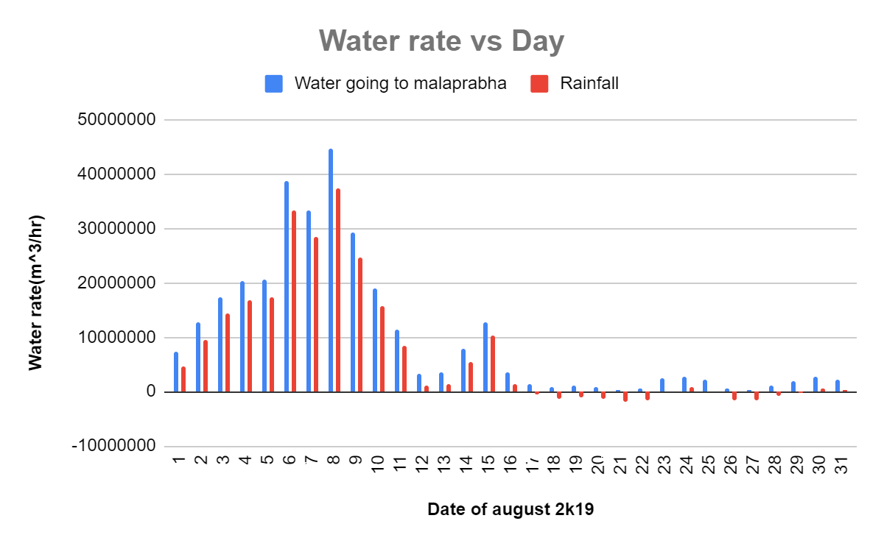

Slide 35
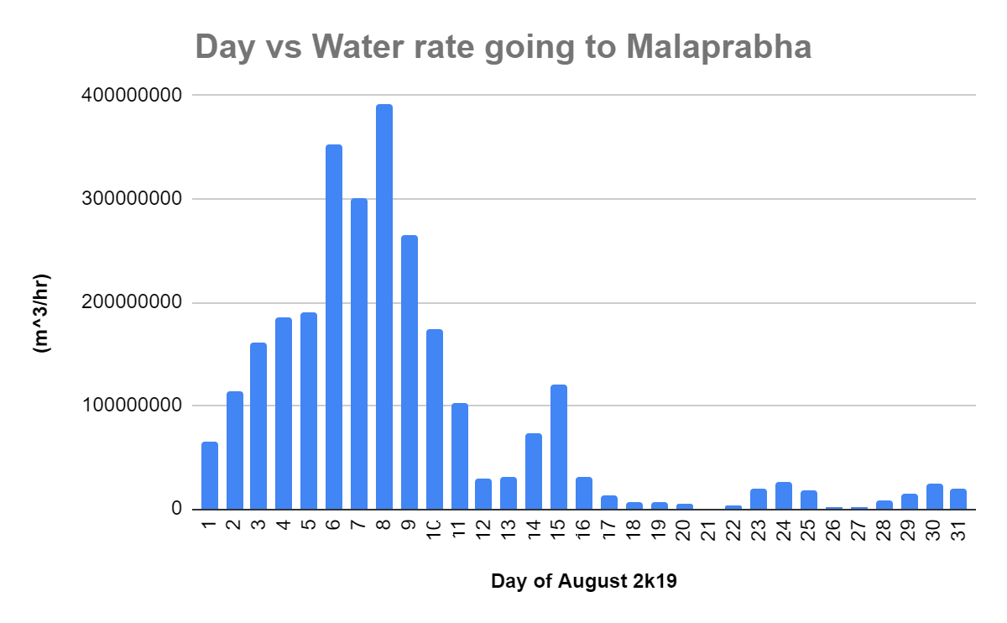

Slide 36
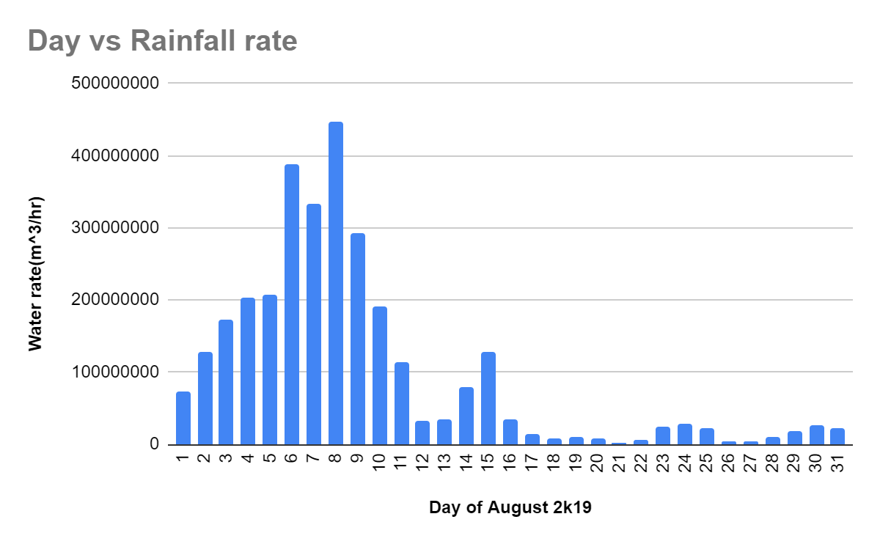

Slide 37
03
FIELD TRIP
We measured the water percolation rate for different soils

Slide 38
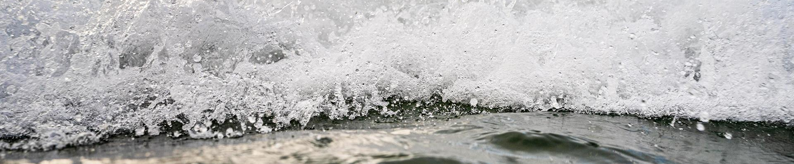
We located four representative sites with the following characteristics:
An area where rainwater enters through cultivated land and then flows towards Malaprabha river or a tributary.
An area with similar land profile, but water from the hills directly enters there.
A place with similar Black Cotton Soil texture, but land has slight slope.
A region of different cover like barren land.

Slide 39
In each of the selected land,we measured the following quantities:
The rate at which water seeps below.
Have a small bore about 2 - 3 metre away and measure the time taken for water to diffuse the distance.
A sample of the soil was taken and chemical analysis will be carried out at the Institute
Some water seeping through the soil was collected and chemically examined at the Institute, including possible silt content.

Slide 40
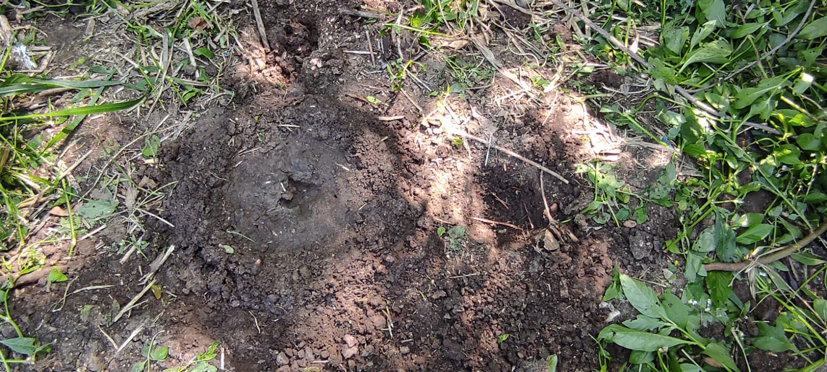
.
MEASUREMENTS OF WATER DIFFUSION IN SOIL
PLACE 1 : KATMALI THANDA
Soil type: Black Cotton soil
Next to farmland exposed to vegetation
Horizontal diffusion of water = ~3 cm/hr
Downward infiltration in saturated soil - less than = ~0.1 cm/hr

Slide 41
.
MEASUREMENTS OF WATER DIFFUSION IN SOIL
PLACE 2 : Shingarkoppa Halla
Soil type: Dharwar craton
On the soil surface
Horizontal diffusion of water = ~3 cm/hr
Downward infiltration in saturated soil = ~0.03 cm/hr

Slide 42
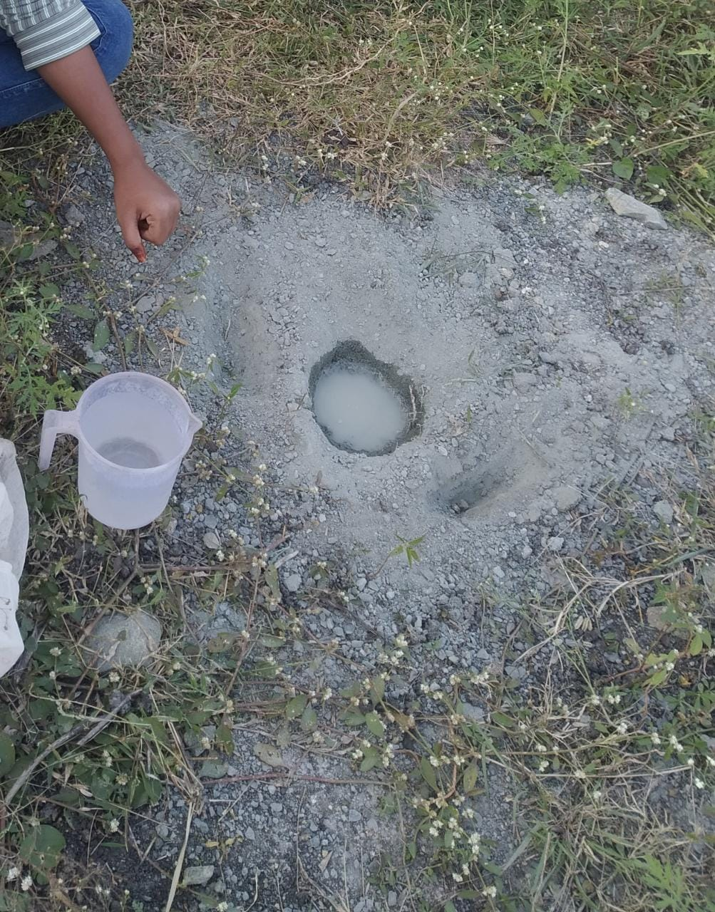
.
MEASUREMENTS OF WATER DIFFUSION IN SOIL
PLACE 3: Shingarkoppa Halla
Soil type: Dharwar craton
10m below the ground
No Horizontal diffusion of water
No downward infiltration

Slide 43
Here we have done experiment at two places and three soils . They are katmalli thanda,Shigarkoppahalla.
The soils are black cotton soil, Dharwad craton soil, dharwad craton soil below 10m.
In these, we got results for infiltration at Shigarkoppahalla drarwad craton soil.
For that we got infiltration=0.03cm/hr, and we used this one in our calculations.

Slide 44
We have done all calculations in excel sheet .
And we have calculated for august 2k19 and here we got rainfall and how much water is going to malaprabha river.
By these calculations, we come to know how much water is going down.
We plotted graphs day vs rainfall, day vs water going to malaprabha, day vs water rate.
This results will help us how much water is going down, how people has to be responsible for storage of water and if we spoil our soil, then absorption rate will decrease and people will place many problems in droughts.
We observed highest rainfall occurred between august 7 to august 9, and at that time floods came.
Calculations link:
https://docs.google.com/spreadsheets/d/1P7G_98Vz9k3eVxDlIpwmqTvj85WJuCjsxR8BeuWW5II/edit?usp=sharing

